Slide 1
DD
Power EnJoy
Design Document
Authors:
Andrea Battistello : 873795
William di Luigi : 864165
14/12/16

Slide 2
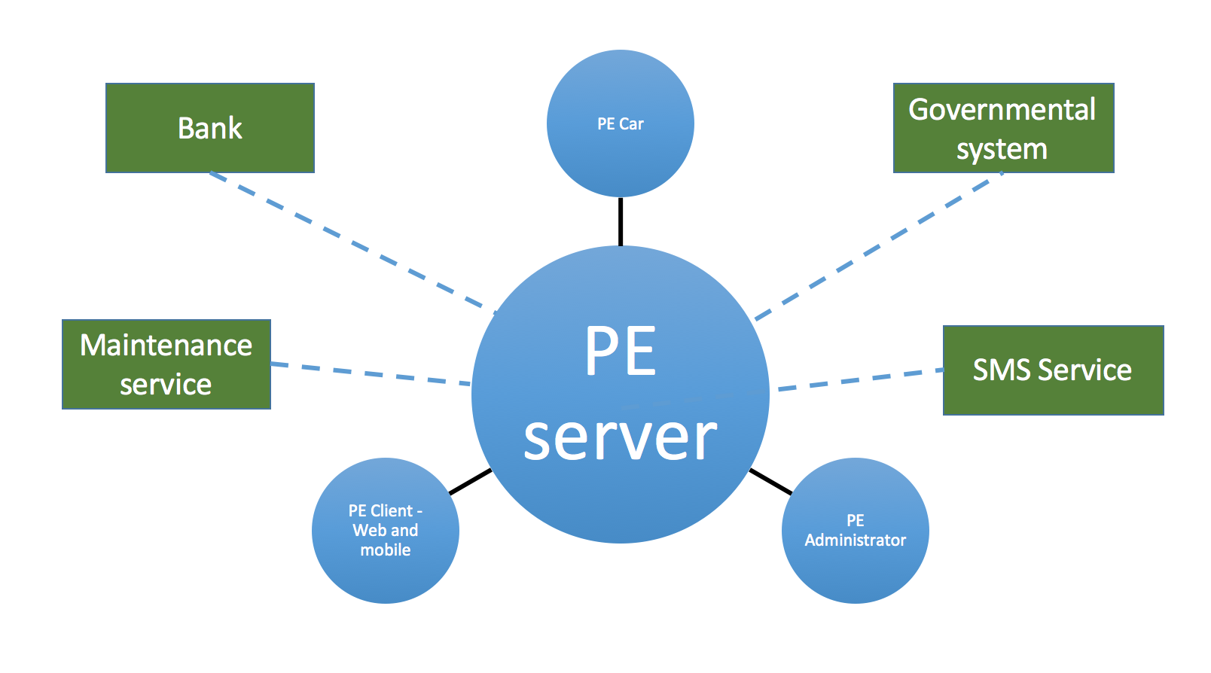
Overview

Slide 3
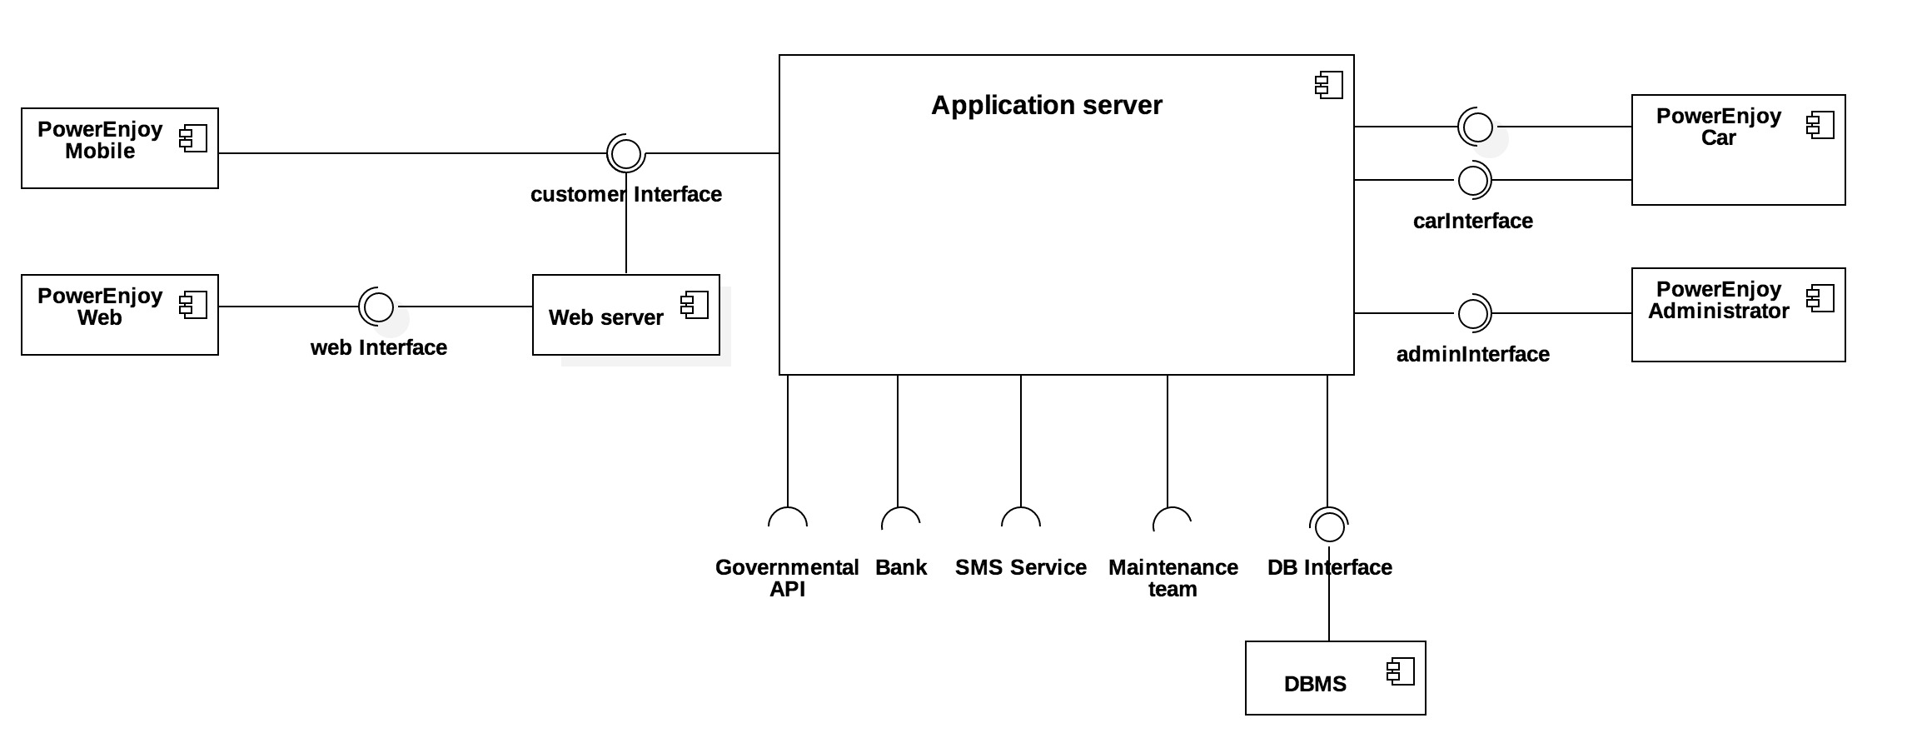
Component view

Slide 4
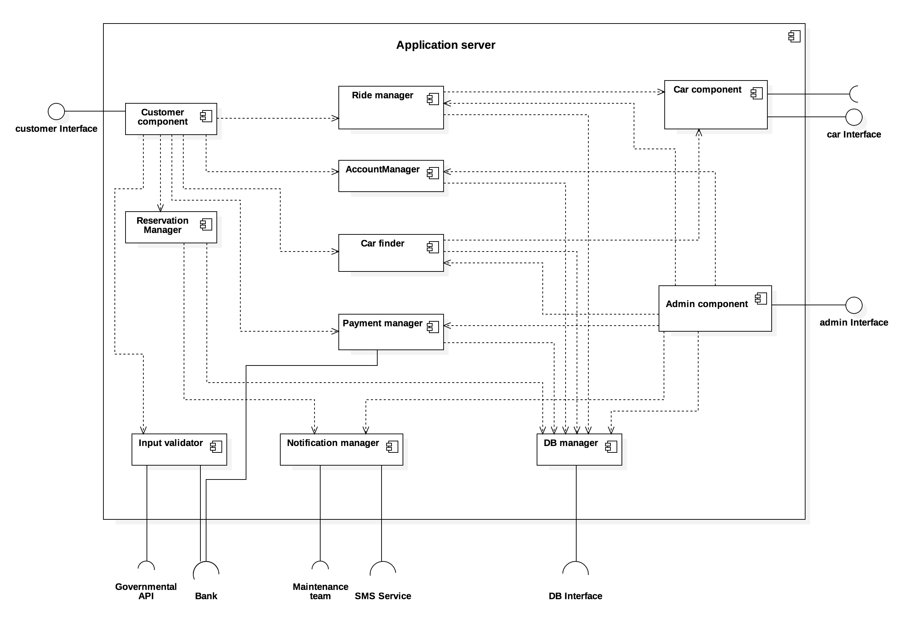
Application server

Slide 5
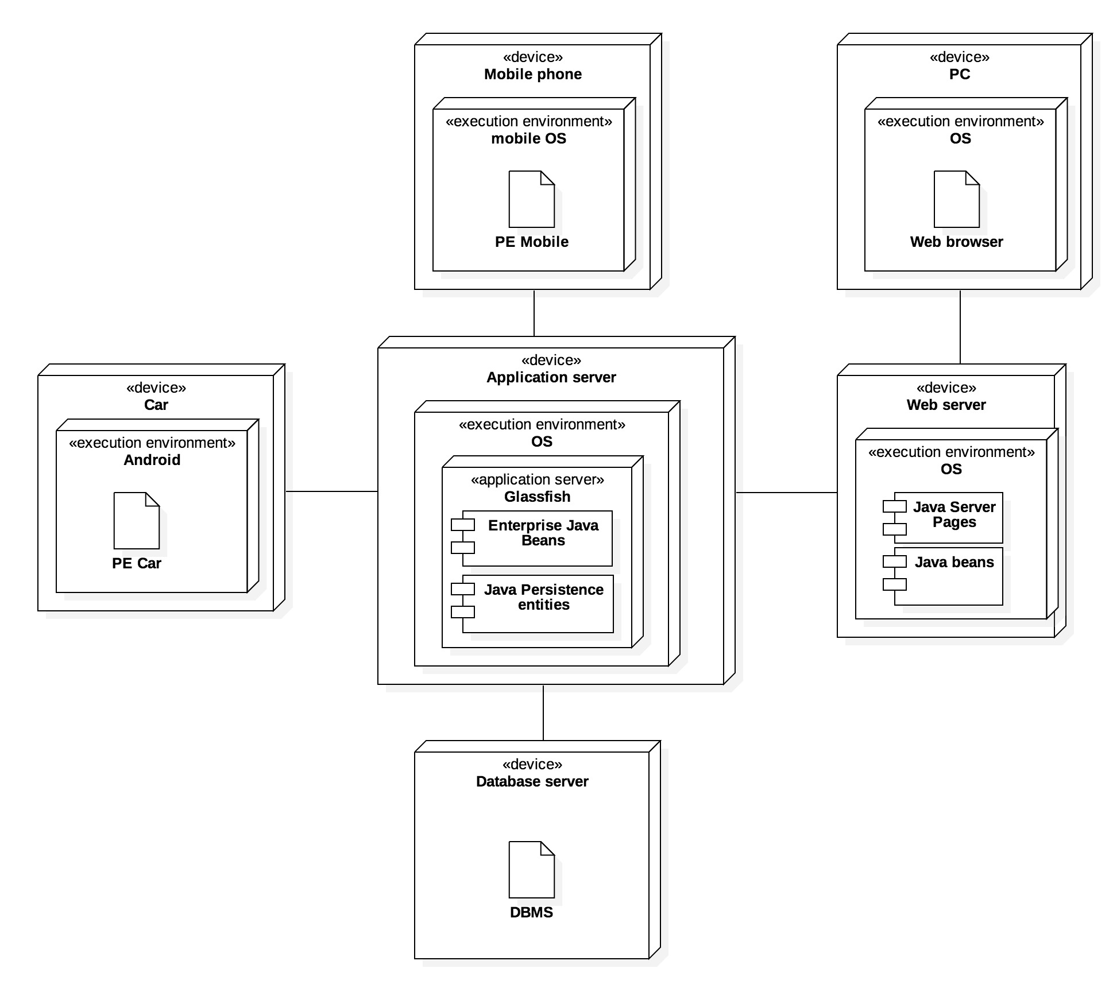
Deployment view

Slide 6
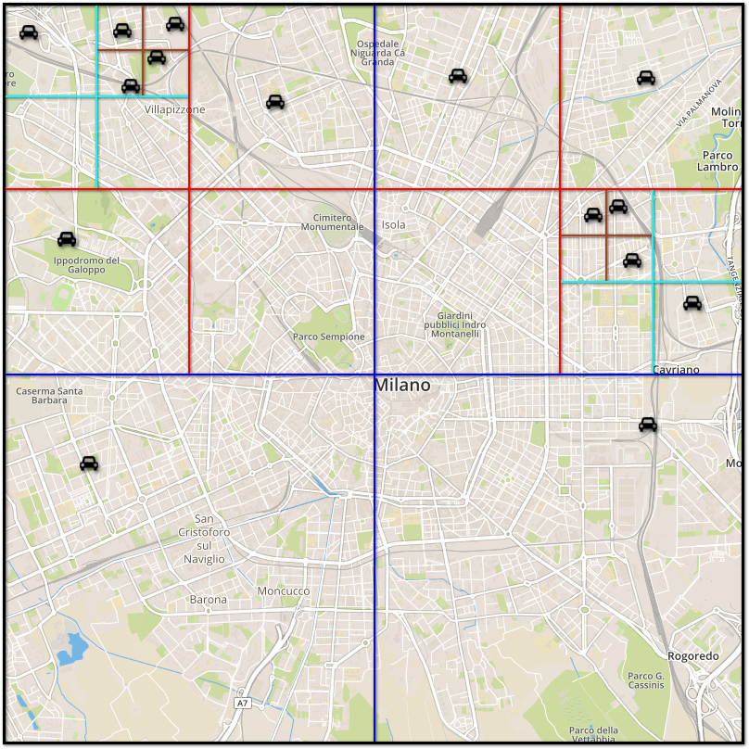
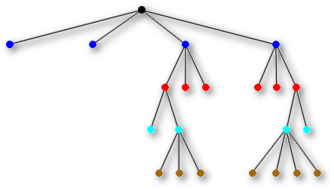
Quad trees

Slide 7
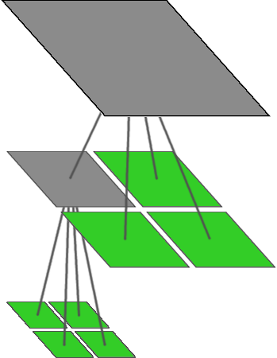
Insert
procedure QuadInsert(C, X) // Try to insert car C at node X in quadtree // By construction, each leaf will contain either // 1 or 0 cars if the subtree rooted at X has more than 1 car then determine in which child Y of node X the car C is in
// Y is either the top left, top right, bottom left, // or the bottom right “quadrant”
QuadInsert(C, Y)
else if the subtree rooted at X has exactly 1 car then // X is a leaf create four children for node X in the Quadtree
// X is not a leaf anymore move the car in X into the child in which it lies
let Y be child in which car C lies QuadInsert(C, Y) else // X is a leaf store car C in node X endif
end

Slide 8
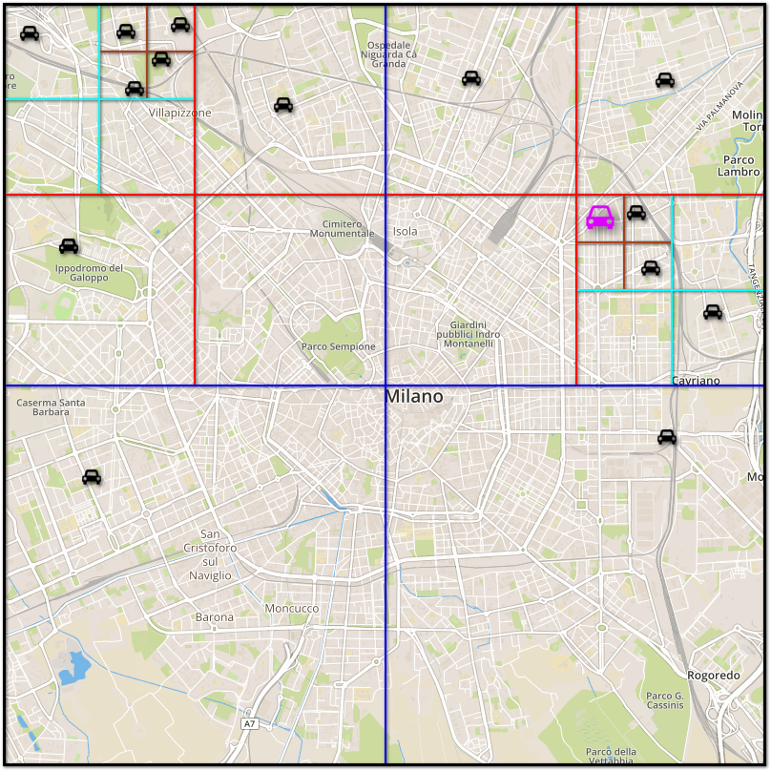
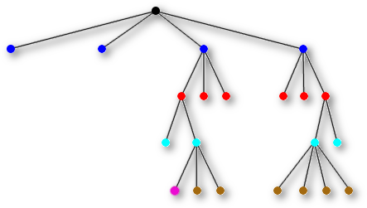
Update car position

Slide 9
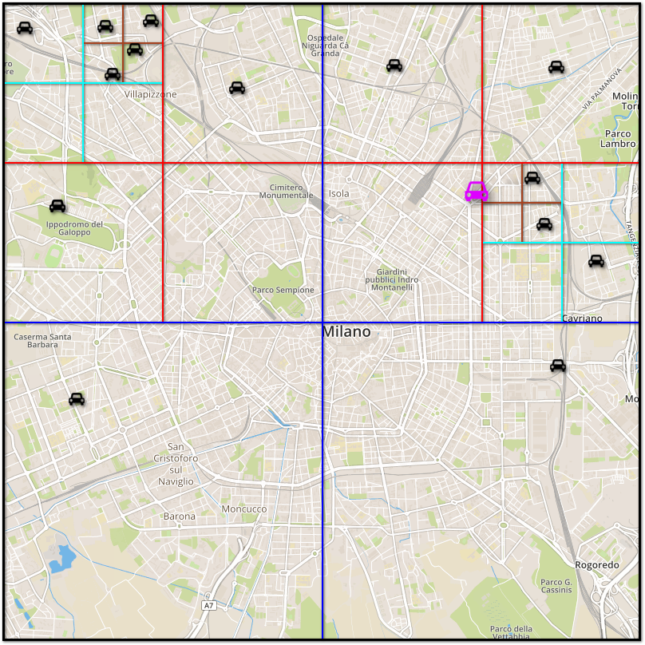
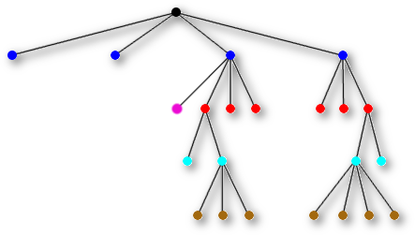
Update car position

Slide 10
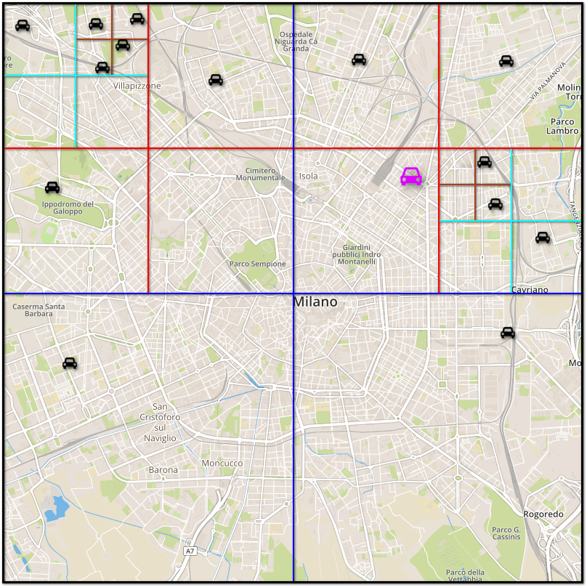
Update car position

Slide 11
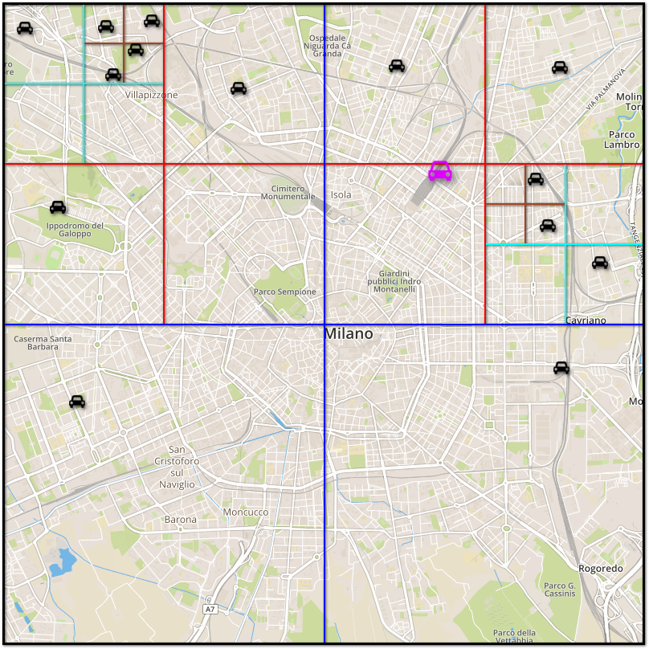
Update car position

Slide 12
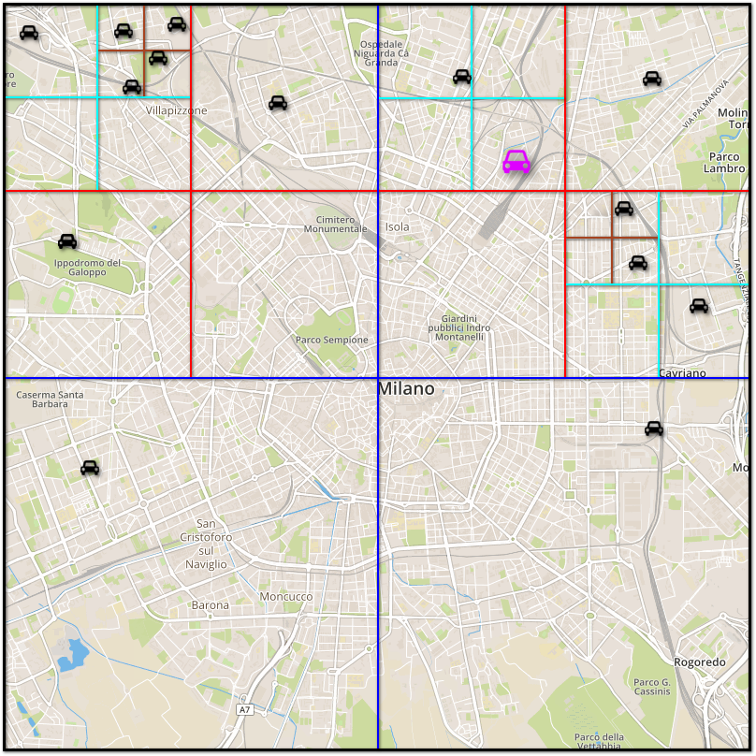
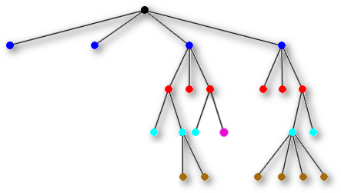
Update car position

Slide 13
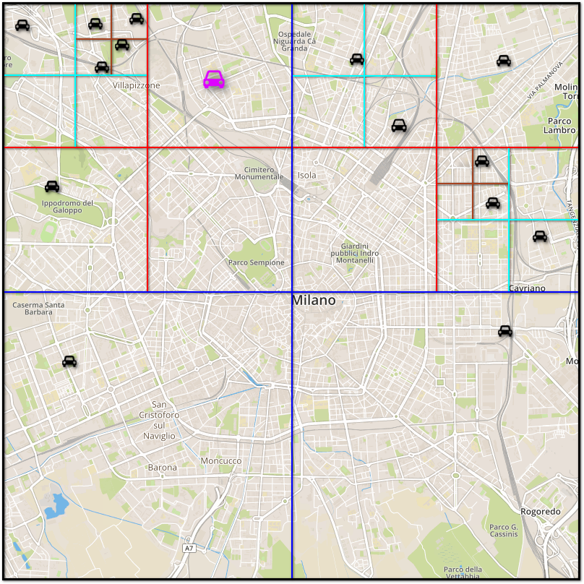
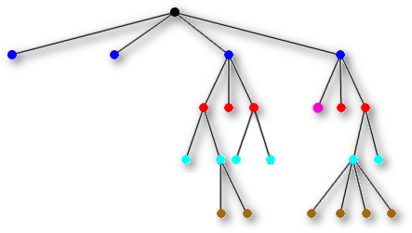
Update car position

Slide 14
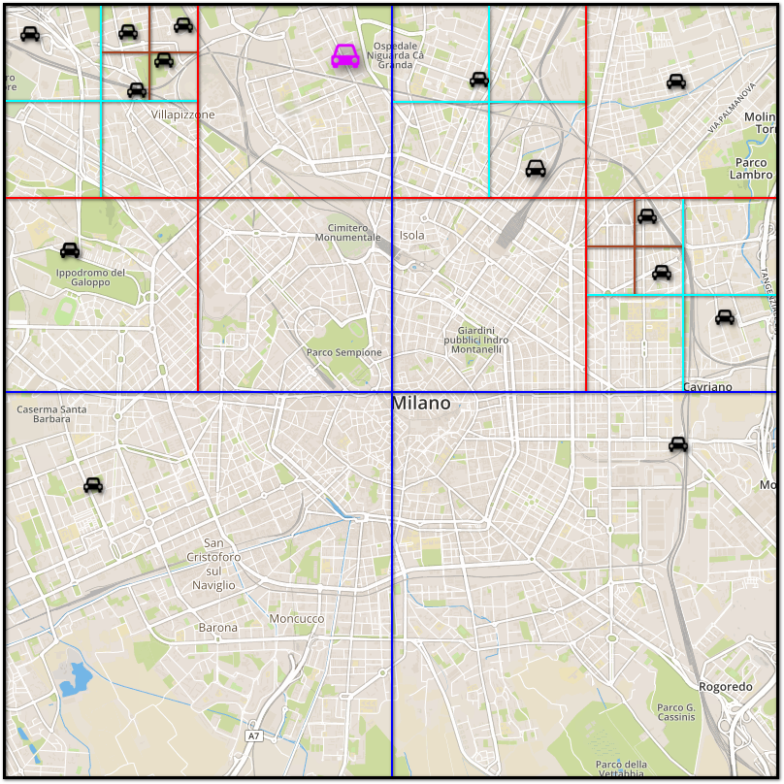
Update car position

Slide 15
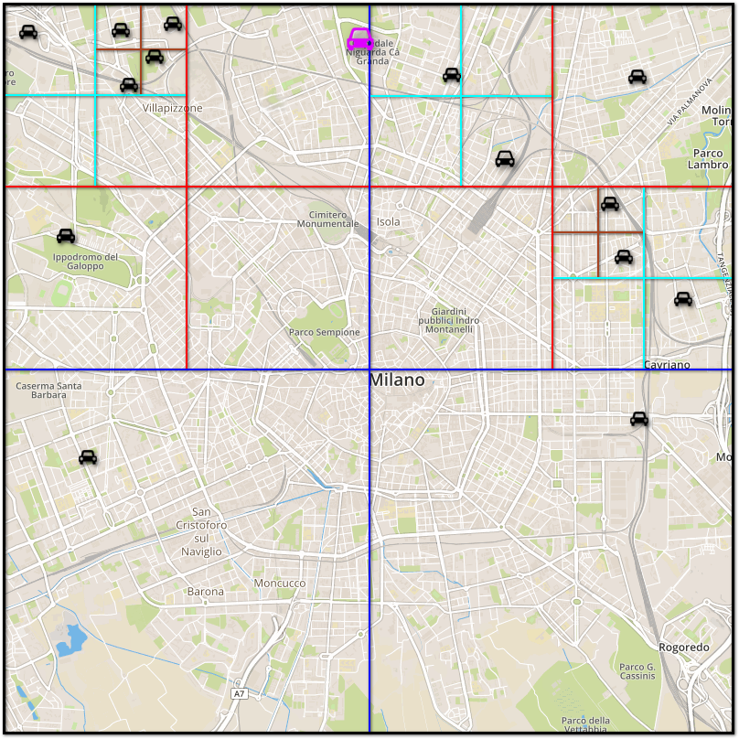
Update car position

Slide 16
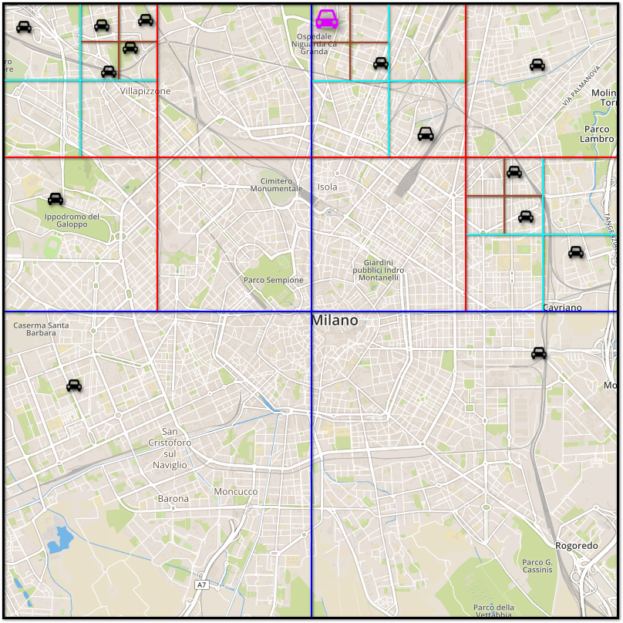
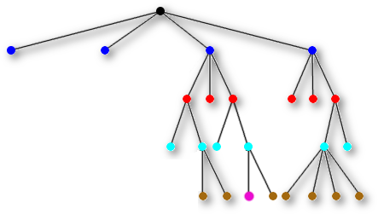
Update car position

Slide 17

List all cars in a given area – Step 1

Slide 18
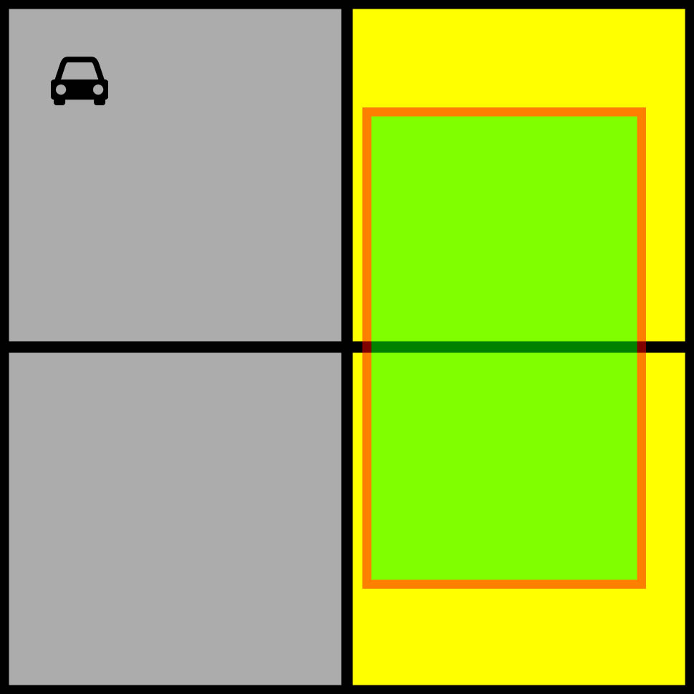
List all cars in a given area – Step 2

Slide 19
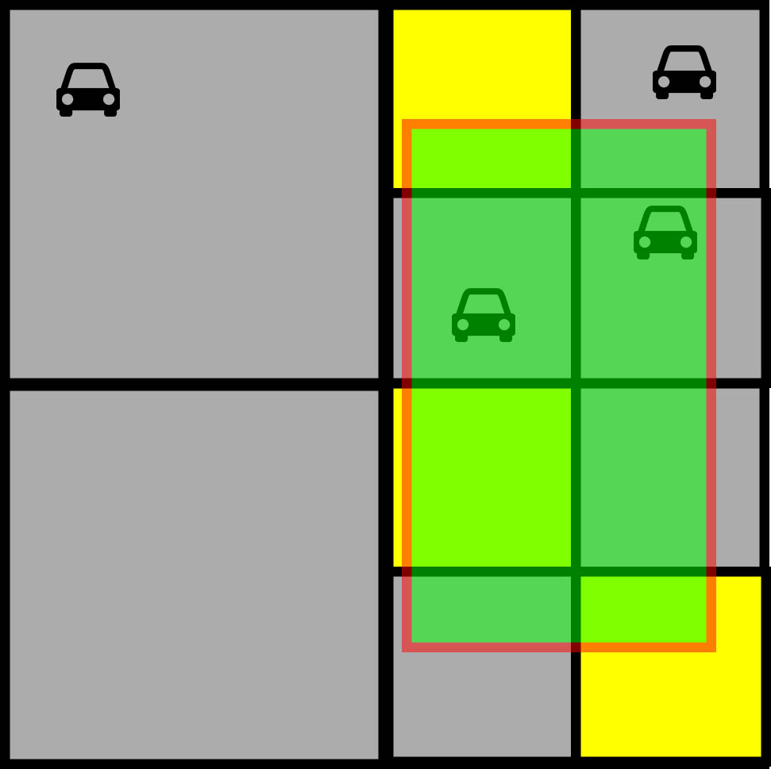
List all cars in a given area – Step 3

Slide 20
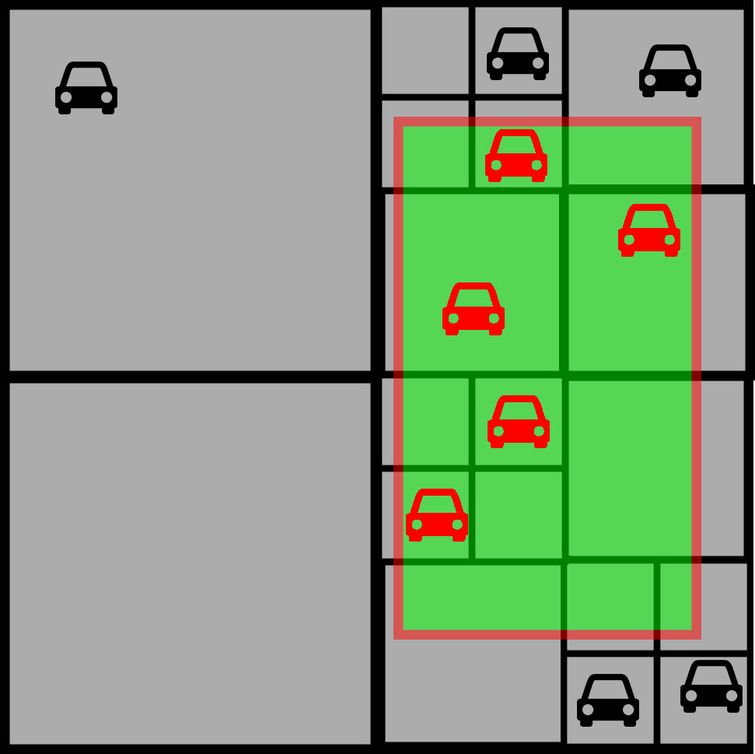
List all cars in a given area – Step 4

Slide 21
List all cars in a given area
procedure QuadList(S, X)
// S is the “query square”, that is: the interesting area // X is the root node, initially is set to root answer = [] // empty list
Y = S ⋂ area(X) // intersection between S and the area of X
if Y ≠ ∅ // non-empty intersection
if X is a leaf
answer += [all cars that are inside Y] // 0 or 1 car
else
answer += QuadList(S, top left of X) answer += QuadList(S, top right of X) answer += QuadList(S, bottom left of X) answer += QuadList(S, bottom right of X)
endif
endif
return answer

Slide 22

We’re done.
Any questions?

